Slide 1


Paxil Voice Assistant Kitty
AI Boot Camp Capstone Project
Team Members:
Gale Gates
Steven Hill
Tatiana Lee
Terry Welsh

Slide 2

Project Overview
The primary objective of this project is to create a voice-activated assistant capable of handling various product-related queries for a paint store.
The assistant can recognize spoken commands, process them, and provide relevant information about the products, including stock levels, prices, and general product details.

Slide 3

Key
Features
To streamline the process of checking inventory, prices, product information through voice commands and general details based on the process commands.

Slide 4

Technologies and Tools
DALL-E to generate realistic images and art from textual descriptions
SpeechRecognition to convert spoken words into text.
NLTK to process and understand the textual commands.
gTTS to transform text responses back into speech.
Playsound to output the generated audio.

Slide 5

Technologies and Tools
Fuzzy Wuzzy: String matching library used to calculate distances between sequences
Python-Levenshtein: Library based on Levenshtein Distance by providing the best matches using fuzzy string matching
CSV Module: For reading and managing product inventory data
OS Module: Provides a way to interact with the operating system.

Slide 6

Project Structure
Inventory data cleaning process
Develop the voice-activated assistant
Implemented command processing
Integrate CSV data
Thorough testing

Slide 7

Data
Cleaning
Real world inventory data pulled from Paint store
Added an inventory count column
Converted coded size to a volume string value
Processed through dataframe keeping only required columns
Output converted data into consumable csv for processing

Slide 8
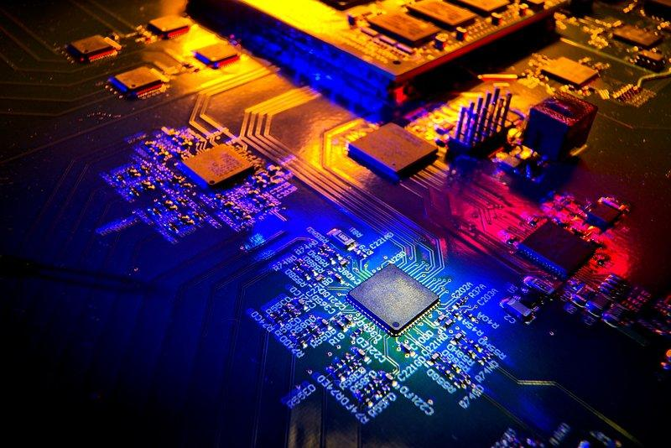
Demonstration
See the Assistant in Action!

Slide 9

Problems Encountered
Gradio Integration Challenges: Inconsistent usage across different development environments (Google Colab, VS Code) hindered project efficiency.
Python Library Familiarity: Lack of expertise required Python libraries slowed down development and problem solving.
Model Accuracy Issues: Initial model struggled to accurately interpret spoken prompts. Implementing fuzzywuzzy improved prompt understanding and overall performance.

Slide 10


Future Considerations
Parameter Optimization: Explore fine-tuning speech and text recognition sensitivity for improved accuracy and user experience.
Multilingual Capabilities: Expand the system’s language support to accommodate diverse customer bases.
Real-World Integration: Seamlessly incorporate the developed system into existing point-of-sale infrastructure.

Slide 11

Summary
A voice-activated assistant for paint stores
Efficiently handles product-related inquiries
Utilizes speech recognition, natural language processing, and text-to-speech
Accesses product information from a CSV Inventory
Provides hands-free and user-friendly shopping experience

Slide 12
